Slide 1

BSc and MSc Programs in
Agriculture & Food Safety at UrSU
Presented for the HEMUA EU—Partnership Workshop
Dr. Khodjaniyazov Elbek, PhD
Urgench State University named after Abu Rayhan Biruni

Slide 2
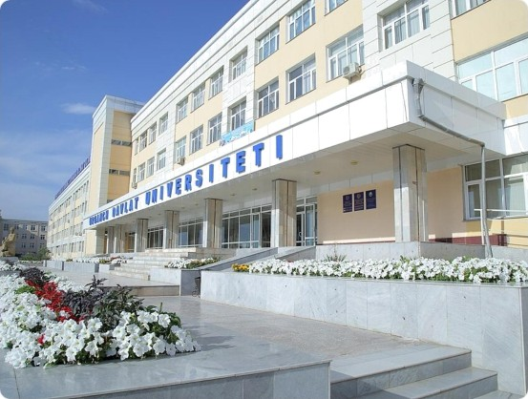
Faculty of Natural & Agricultural Sciences
A multi—disciplinary educational hub focusing on sustainable regional development and agricultural excellence.
Departments: 7 Specialized departments
Programs: 15 Bachelor directions
Community: Over 1,400 active students
Staff: 149 Highly qualified professors

Slide 3
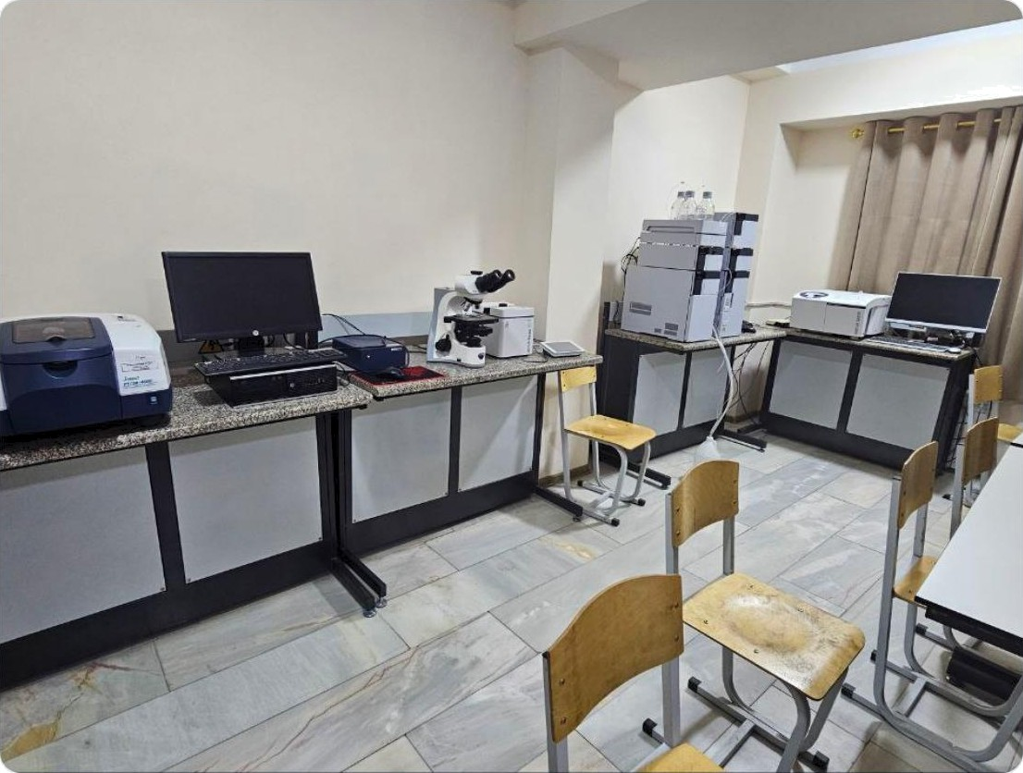
Faculty of Chemical Technology
Bridging Science and Industry
This faculty provides the technical foundation for Food Safety through chemistry and processing technology.
Department of Food Technology: Focused on grain, fruit, and livestock processing.
Chemical Technology: Specializing in organic/inorganic substances for agriculture.

Slide 4
Specialization: Food Safety Technology
Core Subject | Credits | Total Hours | Focus Areas
Food Chemistry | 6 | 180 | Nutrient analysis A additives control.
Physiology of Nutrition | 4 | 120 | Impact of contaminants on human health.
Basis of Food Safety | 4 | 120 | Microbiological intoxications 6 toxicology.
Food Raw Materials | 6 | 180 | Raw material quality & sanitation standards.
Safe Food Production | 7 | 210 | Technological schemes for zero-waste production.
Syllabus Course: 6O72OIOO - Food Technology (Food Safety)

Slide 5






Comprehensive BSc Program Directions
Biotechnology
Focus on medicinal plants processing and environmental protection.
Agronomy
Innovative technologies in soil science, agrochemistry, and plant protection.
Horticulture
Fruit & vegetable growing, viticulture, and
greenhouse management.
Food Tech
Storage and primary processing of agricultural products.
Quarantine
Plant quarantine systems and ecological
safety monitoring.
Forestry
Forestry and greening of residential areas in Khorezm oasis.

Slide 6
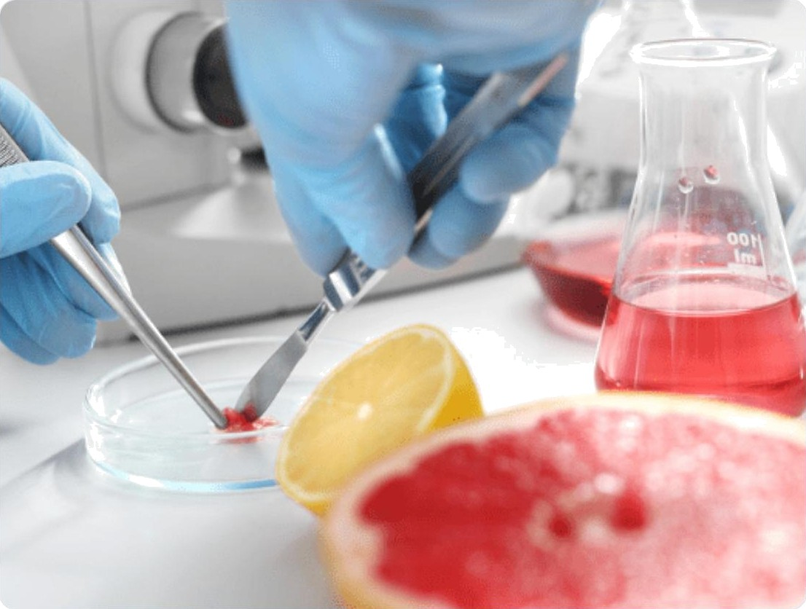
MSc and Doctoral Research (PhD)
MSc Food Safety: Research in toxins control, additives, and shelf—life extension.
MSc Plant Protection: Entomology and bio—ecological pest management.
PhD Soil Science: Salinity management and soil fertility restoration.
PhD Agrochemistry: Modern mineral nutrition and organic fertilization.

Slide 7
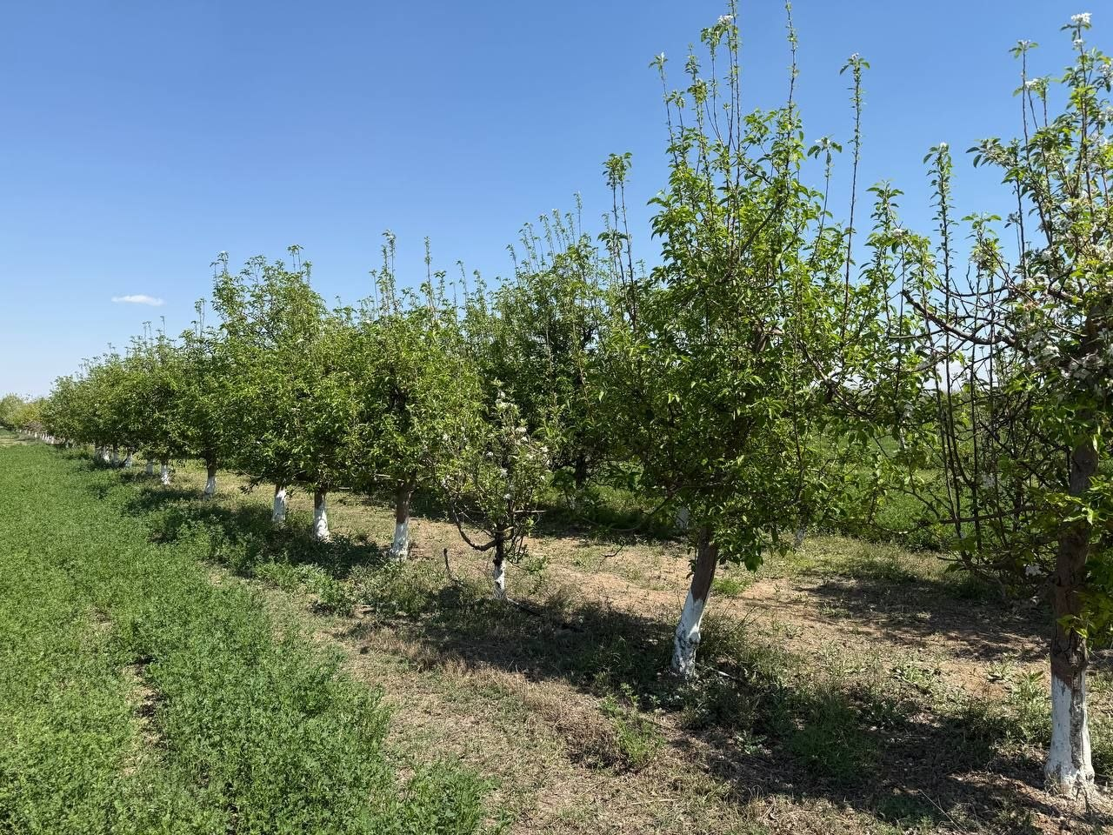
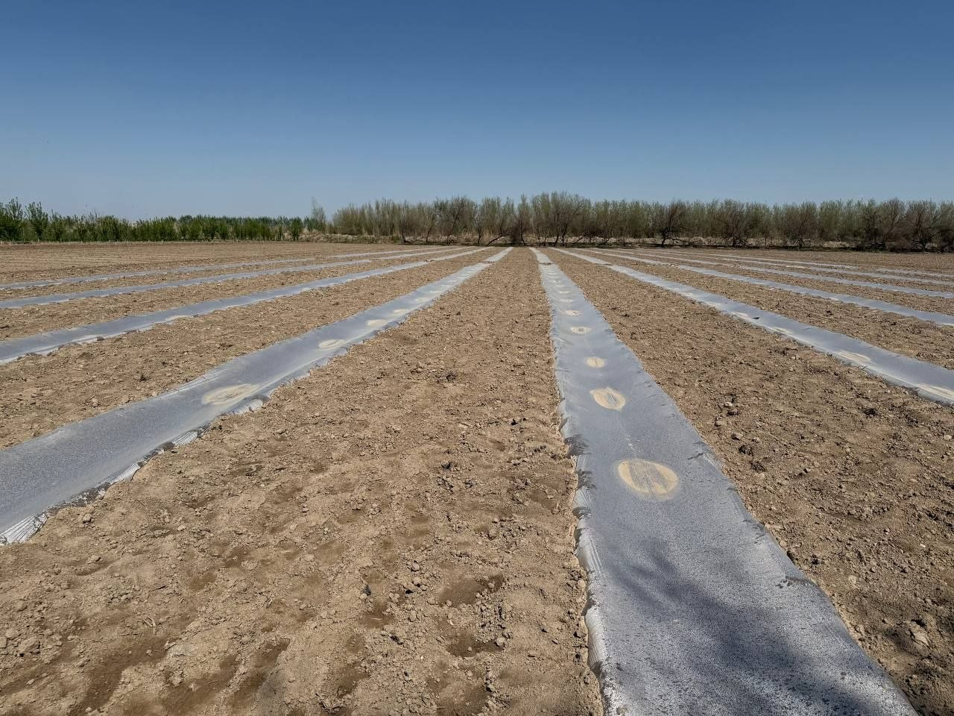
Experimental & Lab Infrastructure
17-Hectare Experimental Farm
Serving as a practical bridge between theoretical science and industrial application.
Intensive apple orchards & fruit testing.
Experimental crop cultivation (Grains & Cotton).
Student—led research on greenhouse dynamics.
Seed cluster collaboration ("Khorezm Fakhri").

Slide 8


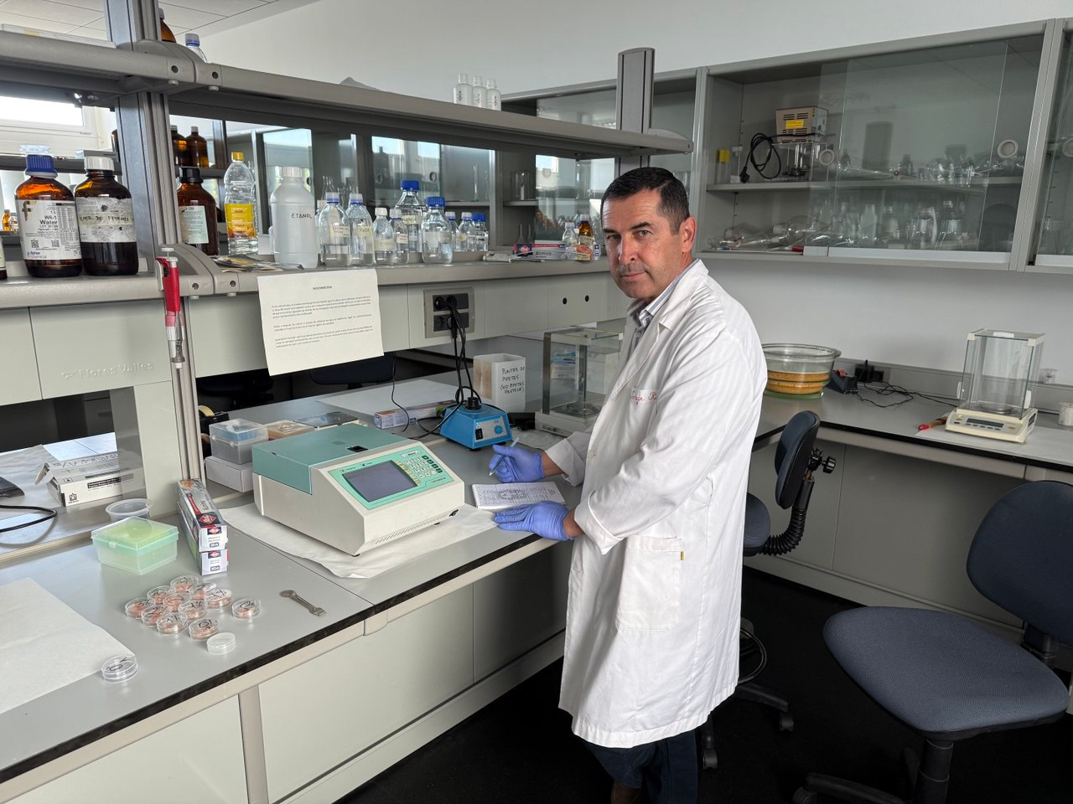
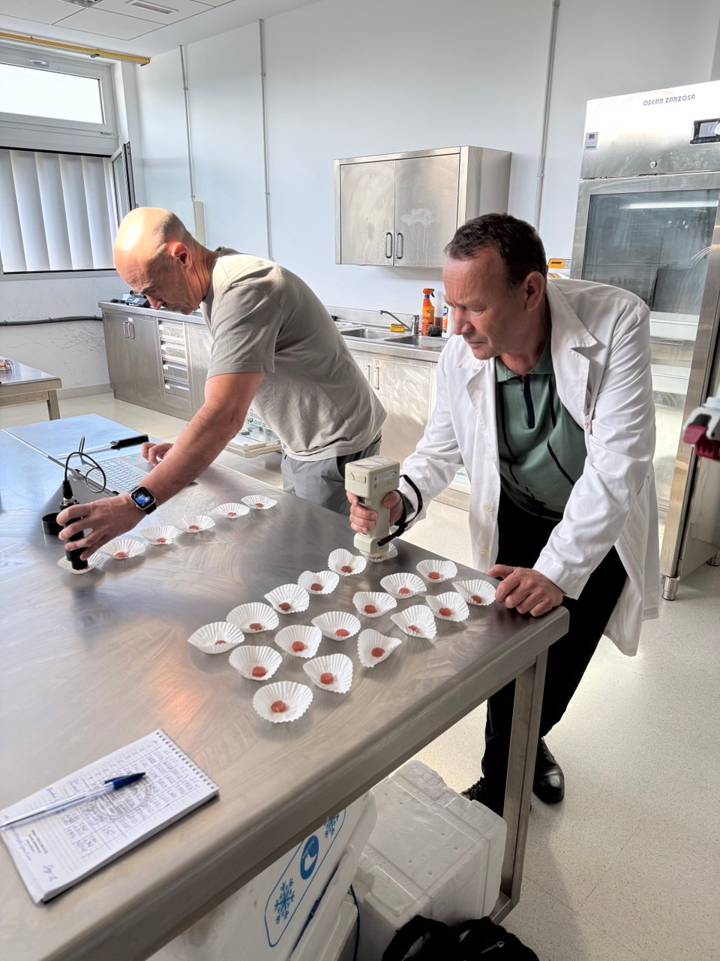
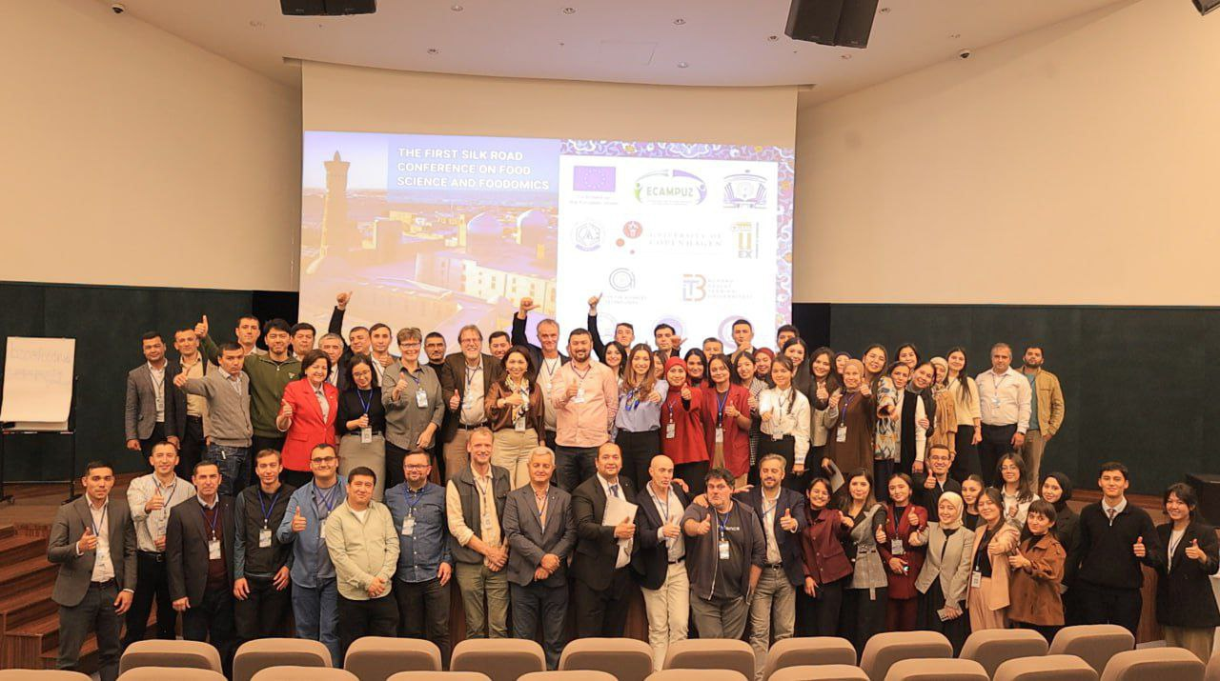
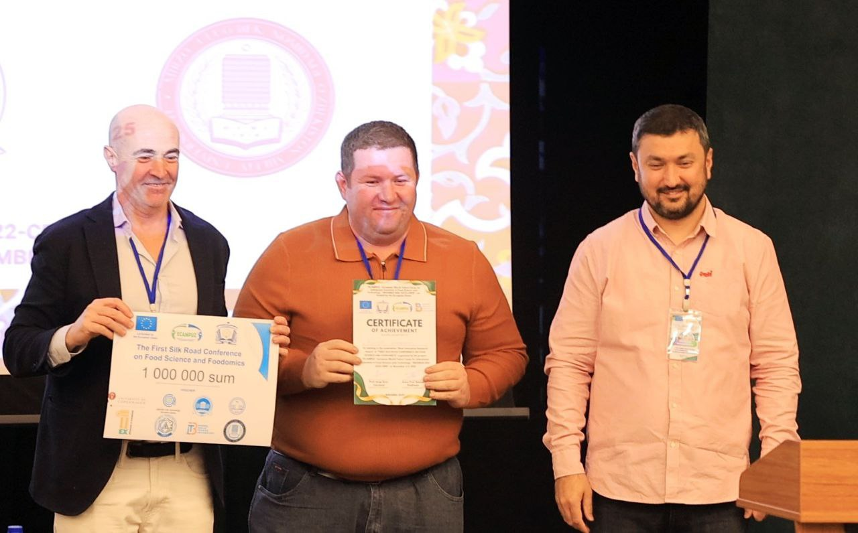
International experience: ECAMPUZ Project
Erasmus+ CBHE framework collaboration
Partners: Spain (Extremadura) and Denmark
CAMP-3 training programs for scientists
Won 'Most Innovative Research Award' (Behzod Kuramboyev)
Foodomics research and lab modernization

Slide 9
Thank You!
Questions and discussion
Dr. Khodjaniyazov Elbek
Urgench State University
www.urdu.uz

