Slide 1
Activities carried on within the HEMUA project at Urgench state university named after Abu Rayhan Biruni
Coordinator Dr. Z.Ibragimov

Slide 2
1. Bachelor and Master students (23) attended to questionaries' as a respondent
2. Developed list of specialized subjects for students
3. Created web portal for student with teaching materials.

Slide 3
List of specialized subjects for the following fields of study
60720100 – Food Product Technology (General Food Products)
60720100 – Food Product Technology (Grain Products)
60720100 – Food Product Technology (Food Safety)
60811300 – Technology of Storage and Primary Processing of Agricultural Products

Slide 4
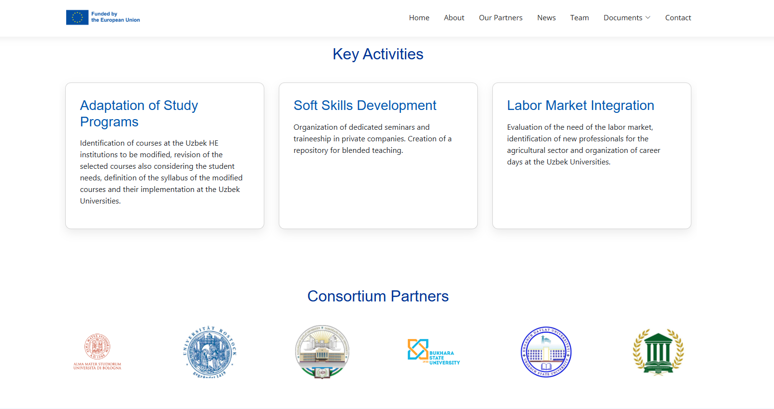

Slide 5


Slide 6
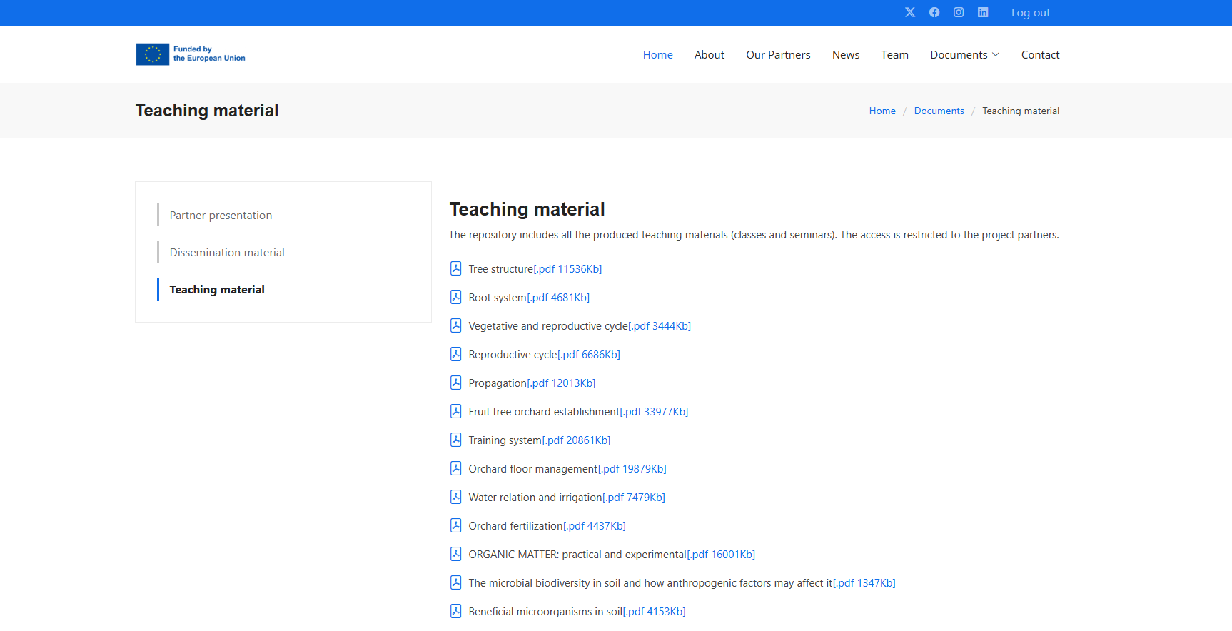

Slide 7
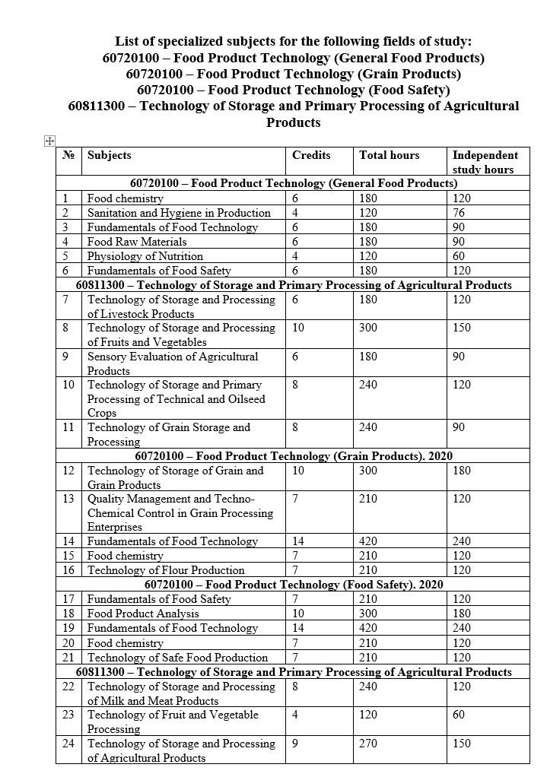
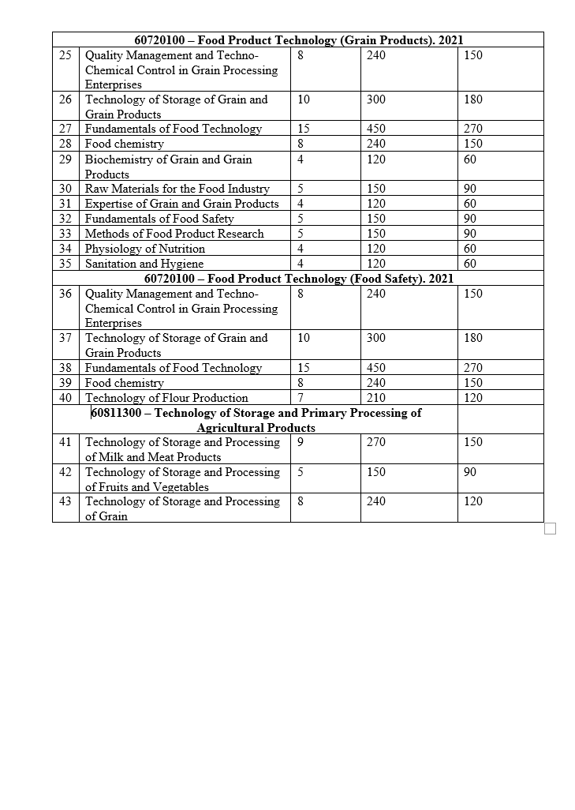

Slide 8


